Slide 1
AI Dungeon Master
Doug Hoover, Hayden Komasz

Slide 2
Intro
What is Our Project?
A dynamically generate text-based RPG inspired by D&D
AI acts as the Dungeon Master
Players input a story prompt and choose characters
Real-Time generation of quests, environments, enemies and dialogue

Slide 3
Motivation
Our motivation was:
To fix the problem with traditional games:
Break away from fixed scripts and pre programmed choices.
Limited player involvement and world interaction.
AI as a storyteller:
Allows for dynamic story creation and telling,
Allows the player to shape the world and game envoirmnemnt to there choosing.
Accessibility without a Dungeon Master:
Promotes to new or inexperince players to enjoy without feeling overwhelmed.

Slide 4
Implementation
Backend:
Built in Python.
Uses OpenAI and DeepSeek API for language generation.
Game runs in the terminal interface.
Character & Combat system:
Custom characters and enemies related to the prompt:
Includes: Health, skills, inventory, damage, and healing.
Skills and items are processed by the API calls and returns a JSON of the effects.
World design:
Story consists of 4-5 locations each tied to:
Unique quests.
Enemy encounters.
The explore function triggers dynamic environment generation.
Quest tracking:
Uses global flags and variables to track:
Quest completion.
Storyline branches.
Unlocks the final boss/location.

Slide 5
Testing
Compared DeepSeek and Gemini
Story Prompts:
Surprise Me
Fantasy
Western
Space
Story :
Timing(API Speed)
Grammar(Grammarly)
Creativity
Consistency(With Story Theme)

Slide 6
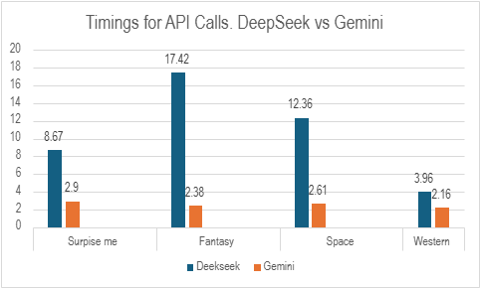
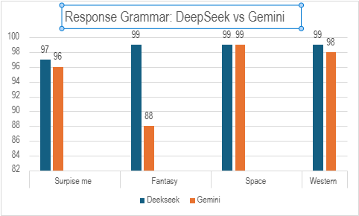
Results
Gemini is often multiple times quicker than Deepseek.
DeepSeek has slightly better grammar on average.

Slide 7
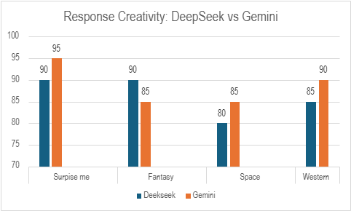
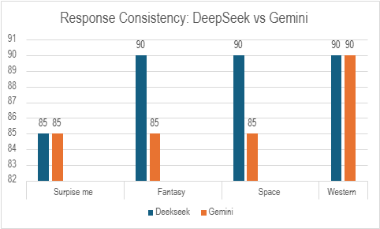
Results Continued
Gemini generated more varied and imaginative responses overall.
Deepseek is better a sticking with the genre/story

Slide 8
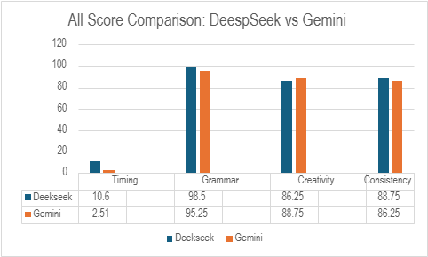
Results Continued
Small difference in grammar, creativity and consistency
Gemini is significantly quicker
Both models struggle generating unique enemy names
Creativity and consistency could be improved with better prompts

Slide 9
Conclusion
Key Takeaways:
LLMs can be used to dynamically create narratives
Gemini is faster and slightly more creative
DeepSeek is more consistent with story and has better grammar
Heavy dependance on model responses causes many issues
Better error handling and prompts for the models could improve the game
Although it can be a fun experience, the lack of reliability of an dynamically generated game often can ruin the player’s experience

